Slide 1
RGB COLOR SENSOR PROJECT Team Sagittarius
Progress and summary until week 2

Slide 2
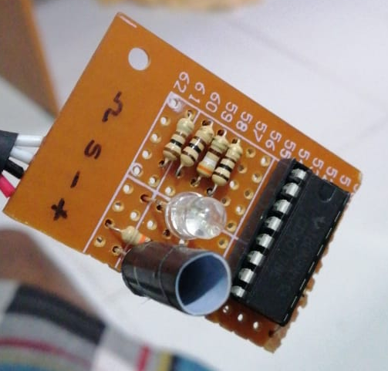
Two basic ideas for the sensing part
Using one LDR & RGB LED
(Later found out as not the best method)
RBG LED
Idea was that object of a given color X, reflects most of the X color light while absorbing most of the other colors.
Therefore, if we can detect the amount of reflection for each Red, Green and Blue light we can roughly estimate the color-composition of the given object.
LDR
(covered to avoid background noise)
But practically, even with proper calibration we were not able to detect some reddish-colors (pink, orange) in an appreciable manner. So, we sticked to our next idea.

Slide 3
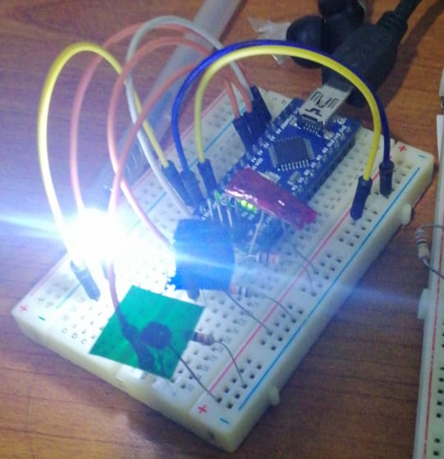
Two basic ideas for the sensing part (contd.)
Using one white LED and 3 LDRs with RBG filters
(Selected to implement, because results were accurate enough!)
Each color filter lets pass only one main color (R,G or B).Therefore, using each LDRs resistance values at a given time we can measure
the amount of each color reflected from the object.
After experimenting with several calibration procedures, we could detect both primary colors and secondary colors accurately.
White LED
By visualizing the almost equal color of the object (on the screen), we verified that the sensor is working correctly.
LDR with
Red filter
LDR with
Green filter
LDR with
Blue filter

Slide 4
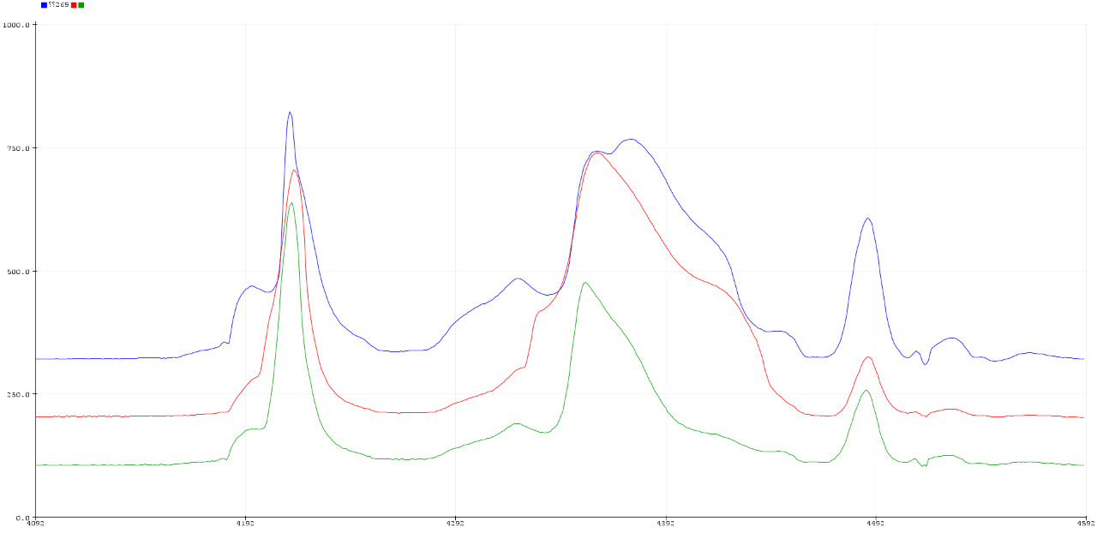
Problems came on the way
Here we are focused on the problems we experienced in the selected prototype
Filters used for each LDR was not doing the filtering process equally
(The amount of passing of light per each color in each filter was different due to selecting various materials
and thicknesses of filters.)
We are experimenting for a proper filter
material and accurate calibration technique.

Slide 5
Problems came on the way (Contd.)
Limited number of available pins
To connect the keypad, we had to use 7 pins leaving us only one pin for other tasks
Using resistors and implementing another circuit we were able to connect keypad with only one analog pin
To connect the display , we wanted 7 more pins
Using I2C or SPI protocols to minimize the pins required.

Slide 6
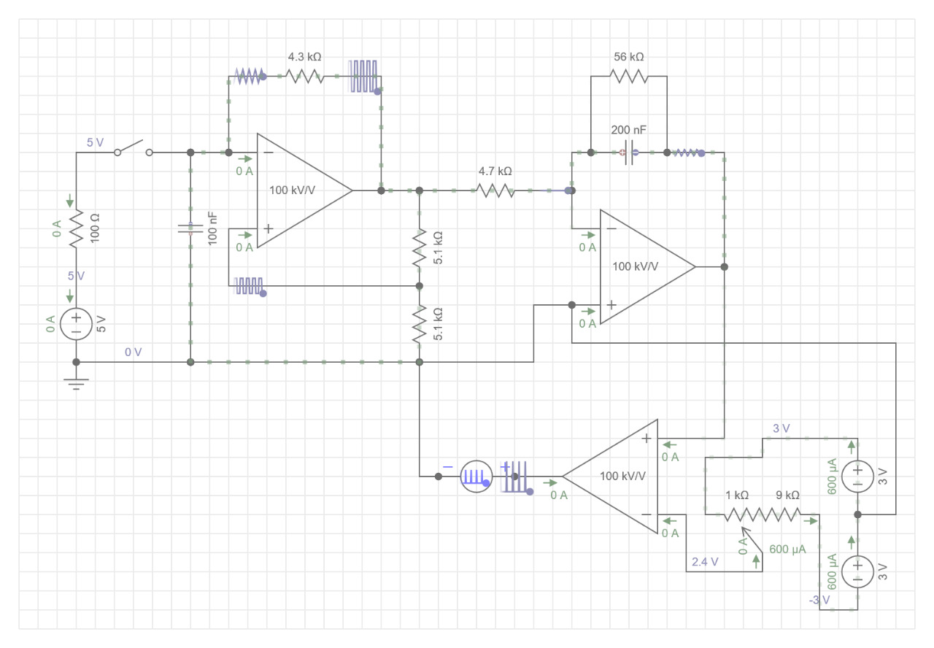
Using only one PWM pin to control the OUTPUT LED was a requirement.
We used a CD4017 to switch between RGBs at 1kHz frequency. And we changed the PWM synchronously.
We used a separate circuit for generate PWM.

Slide 7
Problems came on the way (Contd.)
The distance from the sensor to the object affect the RGB values
We have two possible solutions.
Making the enclosure to have a fixed distance between sensor and object
Using proximity sensor and program it to measure the distance and re-scale
the RBG values

Slide 8
RGB COLOR SENSOR PROJECT Team Sagittarius
Progress and summary – Week 04

Slide 9
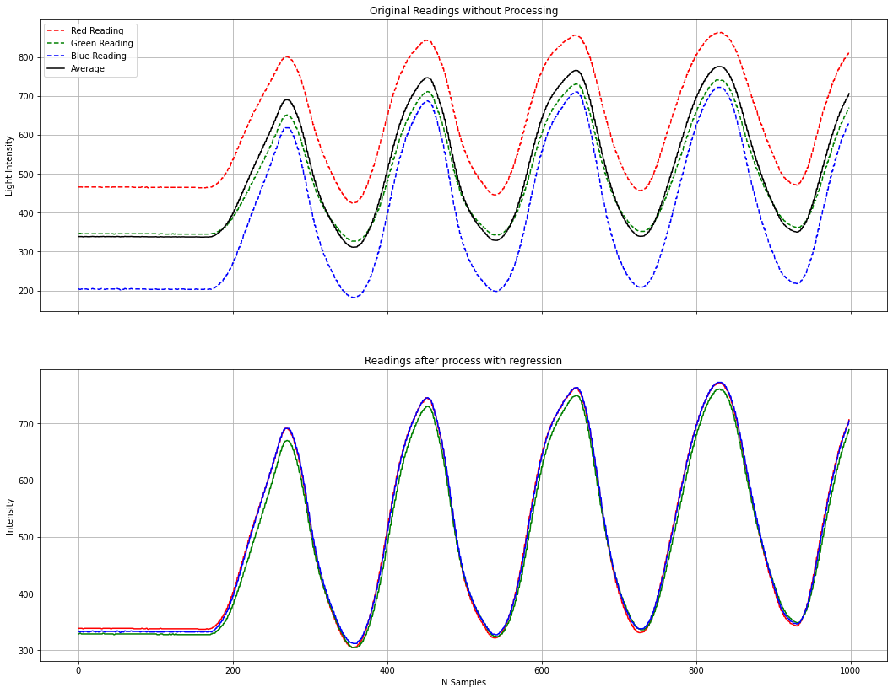
Calibration of the Sensor
Calibration was essential because each of the filters did not response to white light equally.
Therefore, non-linear regression methods were used to transform RGB values to a common ground.
Hyperactive RED
For white light - Changing the distance between sensor and object (hence the ripples)

Slide 10
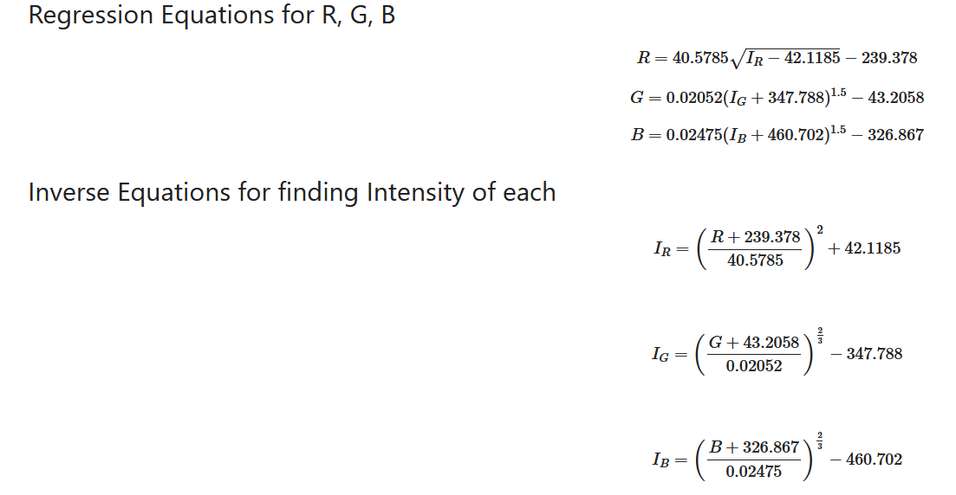
By assuming $y=a{\left(bX+c\right)}^{d}+e$ as relationship between Reading and Intensity, following equation were derived from a graphical approach using DESMOS. https://www.desmos.com/calculator/lbnz0wmogb
Corresponding average for each color
Raw readings for each color
In the case of white light,
These values are equal and depend only on the light intensity.

Slide 11
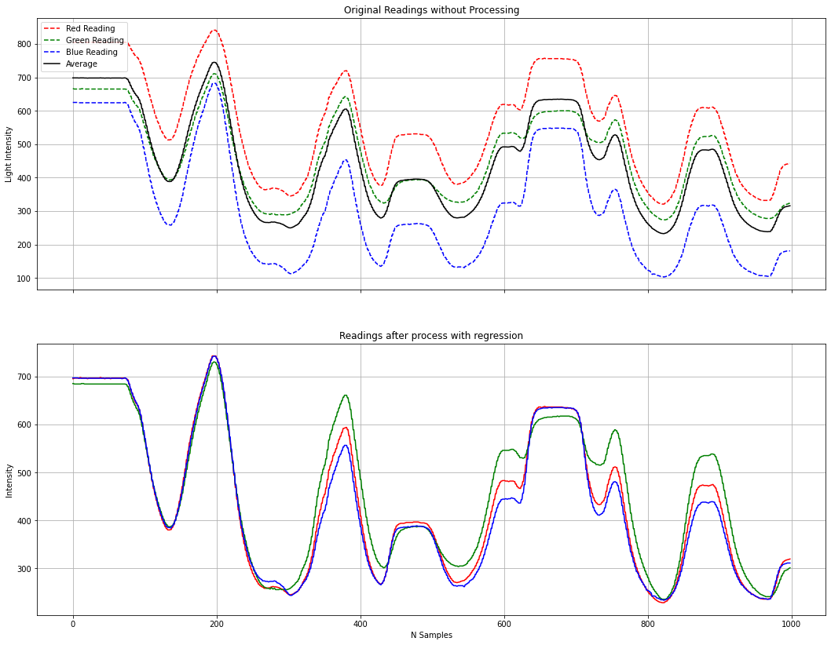
It worked out fine!
Without this calibration, green line always deviated from the expectations.
But now that is also settled.
White Object
Before transform
Green Object
After transform

Slide 12
This calibration is only for current set up
After assembling every component to the enclosure, we will have to calibrate the system once again (same as this).

Slide 13
Keypad and connections

Slide 14
Digital display and connections

Slide 15
Output LED and managing with 1 PWM
Our idea is to use 1 PWM and 2 digital output pins.
Pin | Task
1 PWM | Setting the corresponding intensity of each color
2 Digital Output Pins | Switching to the right color at the right moment
ATMega 328p
PWM
Demux
R
RGB
LED
G
Digital outputs
B
GND
00 → Red
01 → Green
10 → Blue

Slide 16
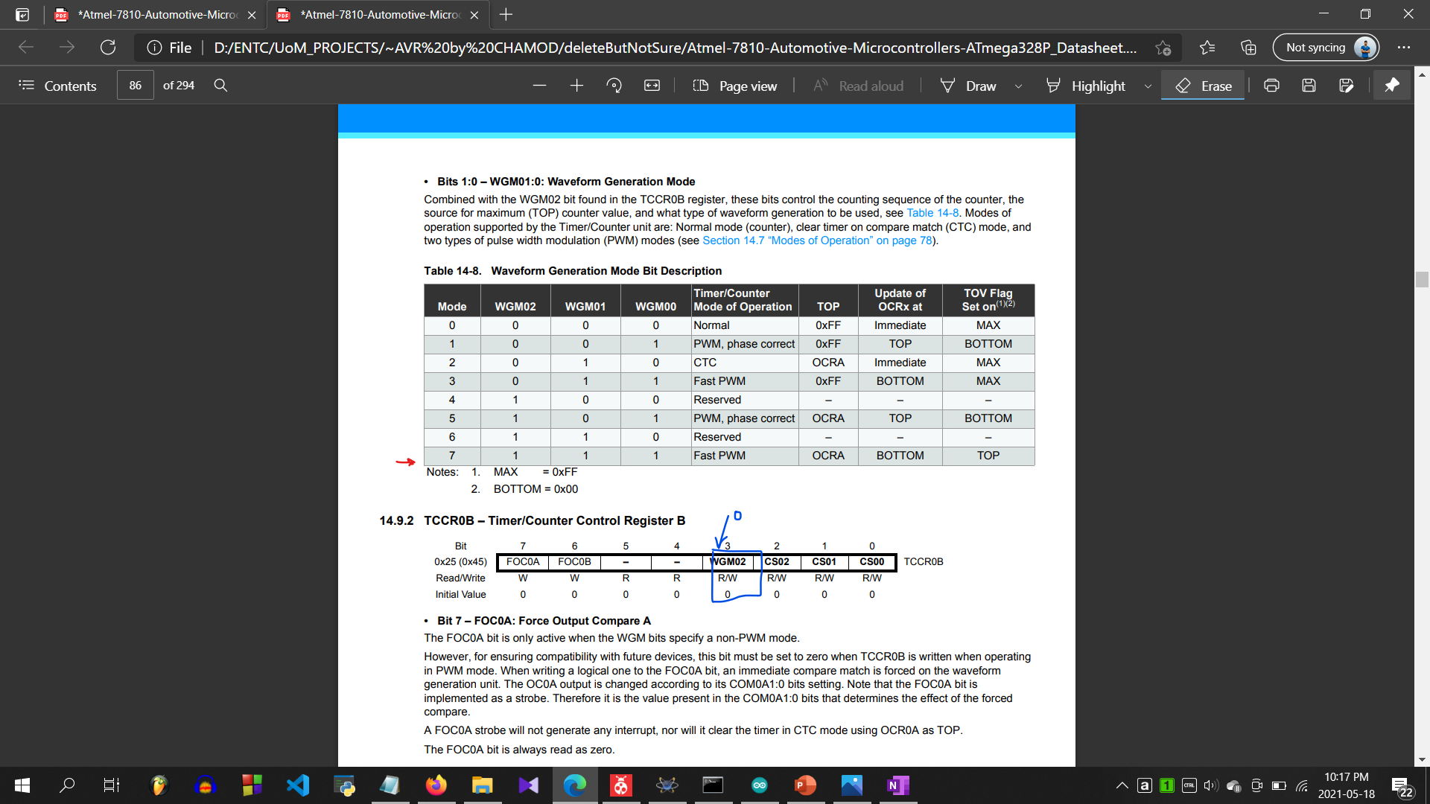
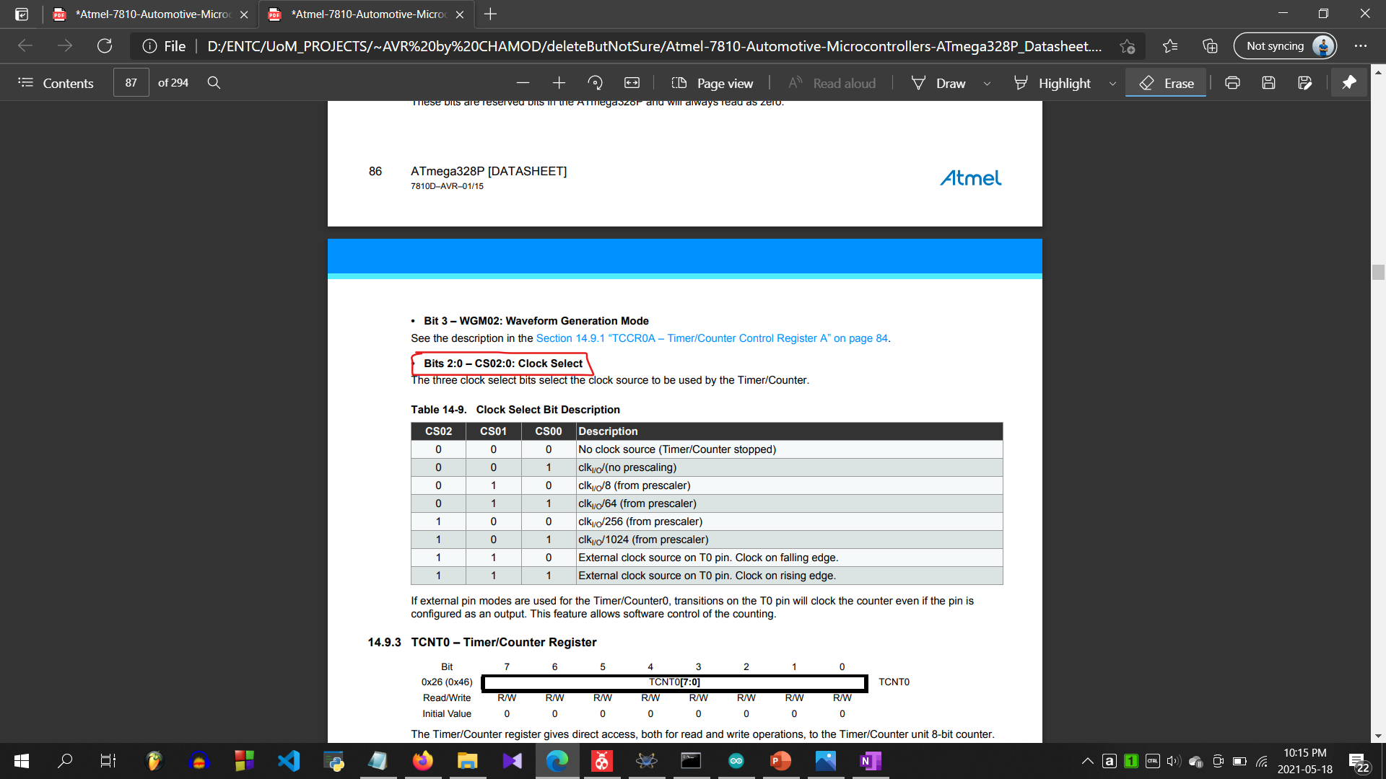

1. Getting the maximum switching speed
With the 16MHz oscillator maximum counter with 256 states have the frequency 31.125kHz
8-bit 256 states
$\frac{16 X{ 10}^{6}}{256}$ = 31.25kHz

Slide 17
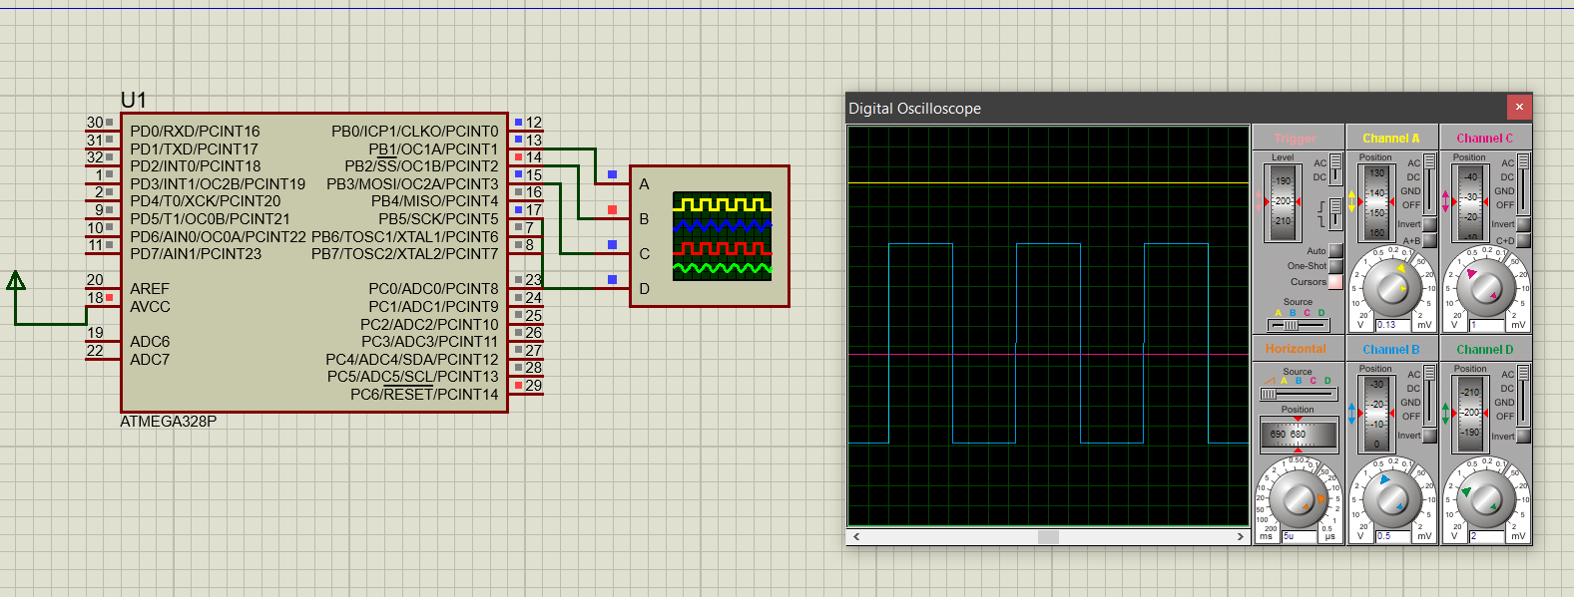
And it was working correctly in Proteus
~32us
For 128 (50% duty cycle)

